Slide 1
Will Debt Undue the U.S. Economy? By Merton Finkler, Ph.D. Professor Emeritus Lawrence University
Talk to Oshkosh Rotary Club
September 21, 2016

Slide 2
Overview
Fiscal Space – Debt Expansion Possibility
History of U.S. Federal Government Debt
When is Debt an Undue Burden? If So, to Whom?
Private Debt can Become Public Debt
How does the US Debt Compare to that of other High Income Countries?
Conclusions

Slide 3
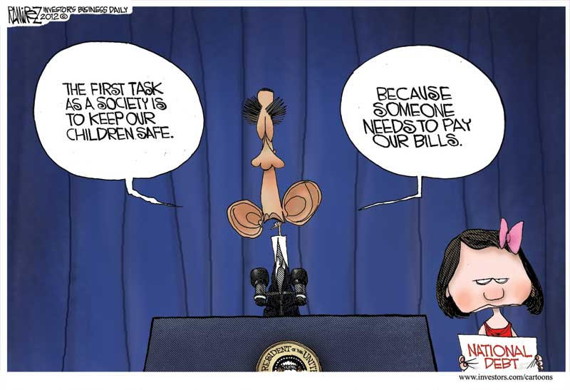
The Burden of the National Debt

Slide 4
Fiscal Space – Room to Expand Borrowing (IMF concept)
Definition: the difference between governmental debt/GDP & the limit beyond which a country will default unless “unprecedented fiscal contraction steps are taken.”
Countries with strong GDP growth and low interest payments tend to have fiscal space.
A country’s borrowing limit depends upon investor confidence, which is based on presumptions about going over a potential “fiscal cliff.”

Slide 5
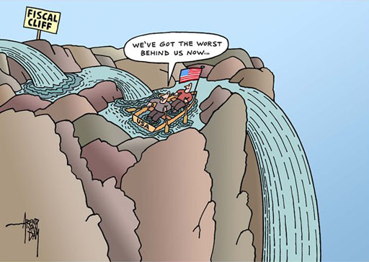

Slide 6
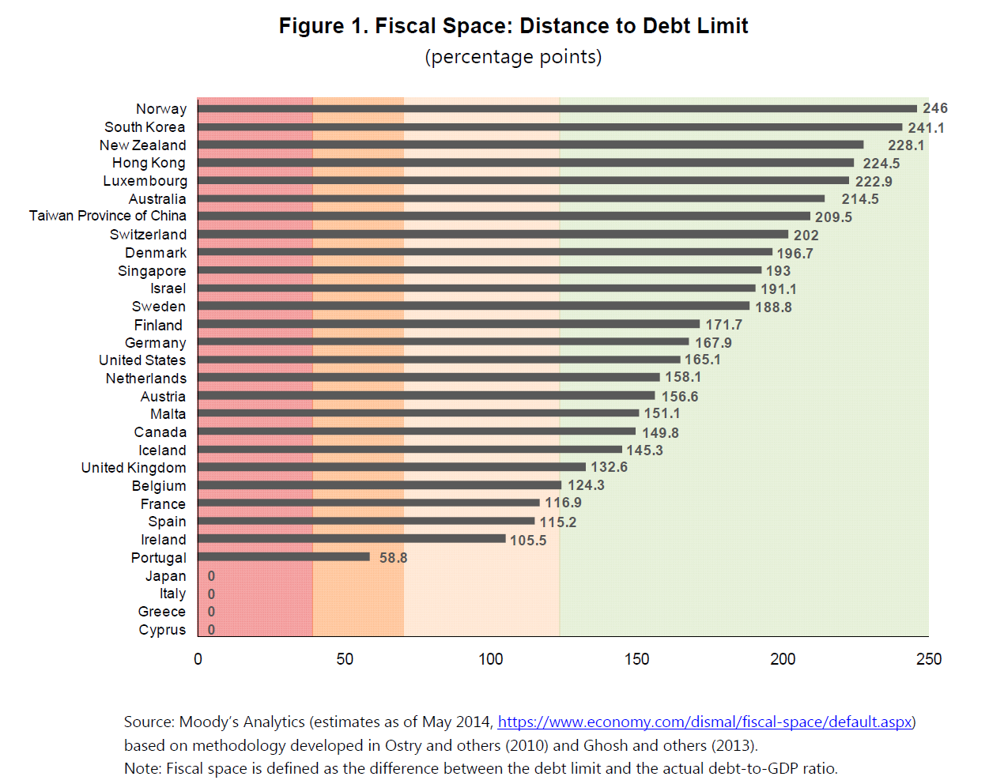

Slide 7
Debt Policy Advice (IMF)
↓ Debt if existent public debt burdens the economy by requiring funds that would otherwise increase economic growth.
Do not ↓ Debt if economy has ample fiscal space and funds can be devoted to economic growth (when distortive cost of ↓ Debt > benefits of crisis insurance)
Debt should be used to smooth taxes when financing “lumpy” expenditures (such as investment in productive infrastructure.)
According to the previous chart, the US has 165 percentage points of debt/GDP of fiscal space for expansion.

Slide 8
U.S. Federal Government Debt
Total U.S. Debt at present - $19.5 Trillion (105% of GDP – http://usdebtclock.org )
Debt held by the public or the Federal Reserve – 76% of GDP
All Sectors - $66.3 Trillion – 358% of GDP
During financial crises, private debt can become public debt – GNMA, FNMA, AIG, banks

Slide 10
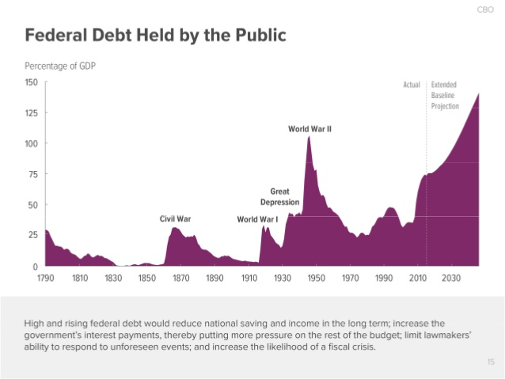

Slide 11
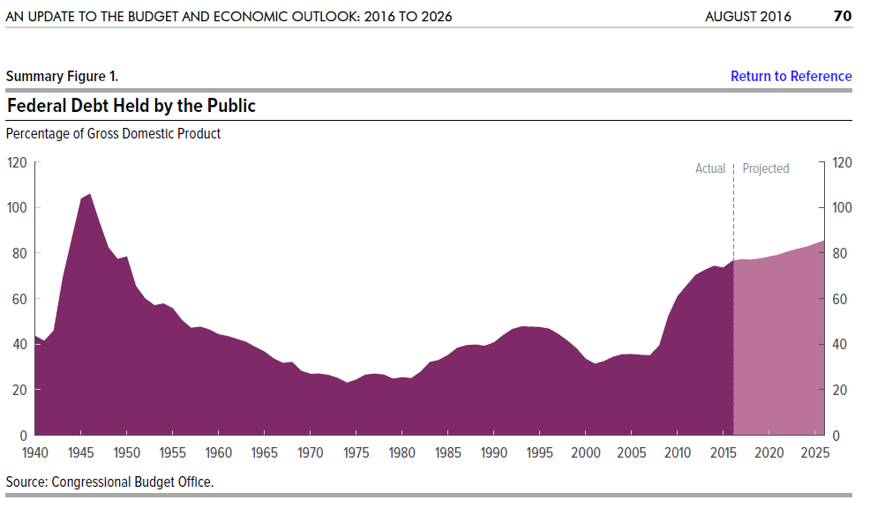

Slide 12
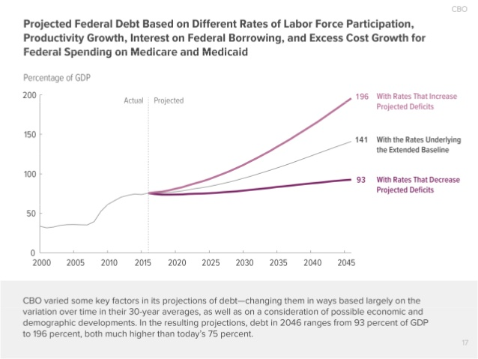

Slide 13
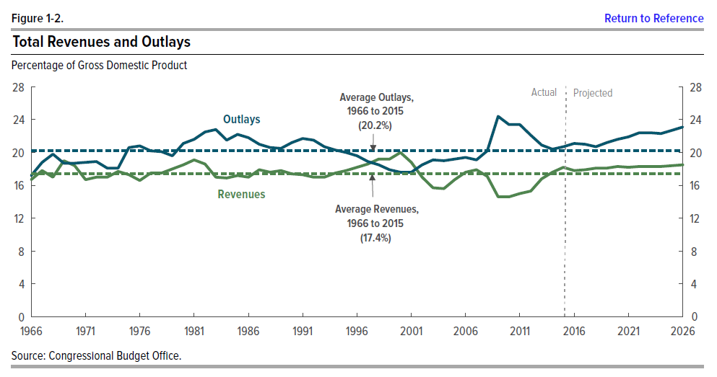

Slide 14
Who Bears the Burden of the Debt?
View 1: Future generations
Fiscal contraction required in the future
View 2: Present generation
Holders of debt devote funds to less productive places (crowding out of private investment)
Current generation increases savings to help with prospective burden of next generation
View 3: Export debt to foreign holders
Little burden: Crowding in through increased aggregate demand which increases GDP
Hidden burden: Printing money to payoff debt ↑prospective inflation, ↓value to debt holders, and imposes burden on those least able to cope with inflation.

Slide 15
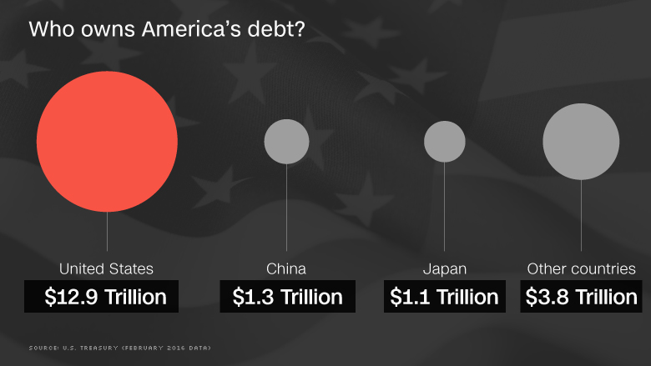
Who Owns Government Debt?

Slide 16
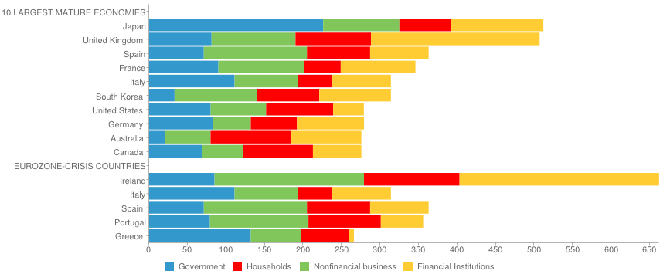
Debt Composition as % of GDP
Notes:
We can’t just look at government debt. Key source varies across countries and across time.

Slide 17
Critical Determinants of the Burden of Debt
Demographics: Can the work force support the dependent population?
Entitlements: Will future commitments undermine potential economic growth?
Reaction: Will foreign holders continue to hold $ denominated securities?
How large a margin of safety is desired?

Slide 18
This Time is Different (NOT!) – Carmen Reinhart and Kenneth Rogoff
“Excessive debt accumulation, whether it be by the government, banks, corporations, or consumers, often poses greater systemic risks than it seems during a boom.”
“Such large-scale debt buildups pose risks because they make an economy vulnerable to crises of confidence, particularly when debt is short term and needs to be constantly refinanced.”
Highly leveraged economies “can seem to be merrily rolling along for an extended period, when bang! - confidence collapses, lenders disappear, and a crisis hits.“
Eight centuries of experience suggests this time is not different.
Once Government Debt/GDP > 90%, GDP growth drops by 1%
Financial crisis generated recessions take longer to emerge from than non-financial crises.

Slide 19
Conclusions
U.S. needs to bring entitlement growth in line with income growth which will require at least one of the following:
Restricting benefits
Expanding taxes
Growing income
Much more efficient use of medical care
A much healthier population
Debt should be used to pay for investments that generate a return sufficient to pay them off.
In my view, current debt is not problematic, especially if used to make the labor force more productive.
Prospective debt is problematic and should be addressed long before difficult choices must be made.

Slide 20
Thank You for Your Attention
Questions?

Slide 21
